Slide 1
Building Simple Web App
HTML - CSS - JavaScript
https://bit.ly/3gG4HwS

Slide 2


Introduction
Sudarat Chattanon (Gatuk)
Community Organizer @ PyLadies Bangkok
Engineering Manager & Software Engineer @ PRODIGY9 gatukgl

Slide 3
Outline
> Basic HTML & CSS
> JavaScript Syntax
> How to use JavaScript in HTML
> Building a web app

Slide 4
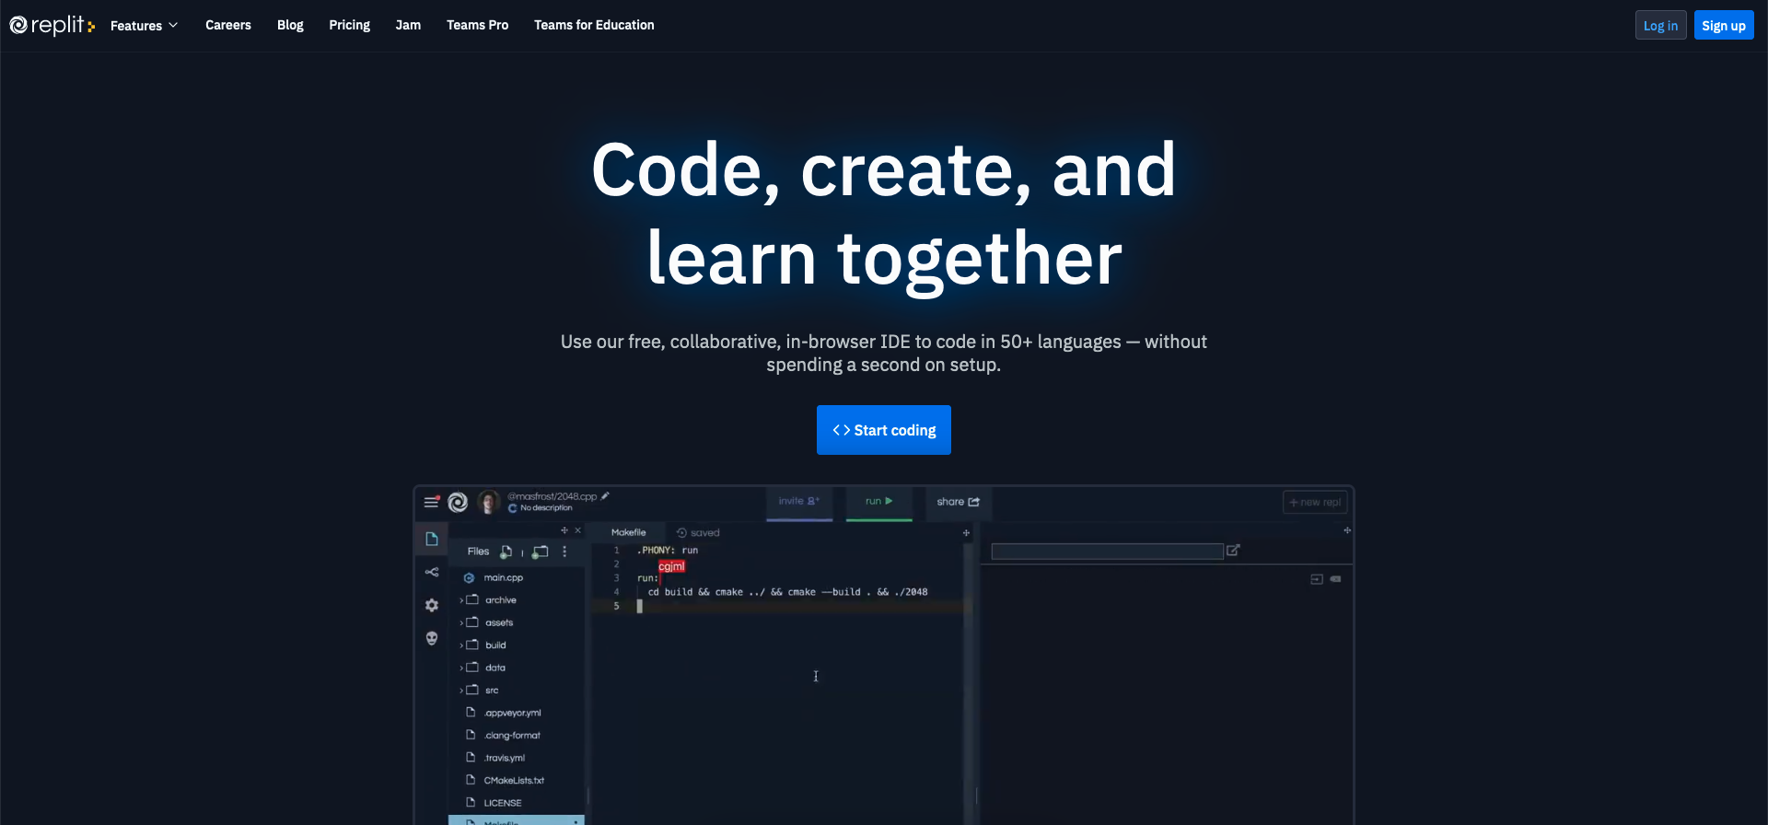
Tool
https://replit.com/

Slide 5
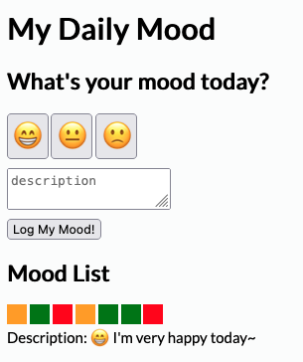
Goal

Slide 6
Material
😀 😃 😄 😁 😆 😅 😂 🤣 🥲 ☺️ 😊 😇 🙂 🙃 😉 😌 😍 🥰 😘 😗 😙 😚 😋 😛 😝 😜 🤪 🤨 🧐 🤓 😎 🥸 🤩 🥳 😏 😒 😞 😔 😟 😕 🙁 ☹️ 😣 😖 😫 😩 🥺 😢 😭 😤 😠 😡 🤬 🤯 😳 🥵 🥶 😱 😨 😰 😥 😓 🤗 🤔 🤭 🤫 🤥 😶 😐 😑 😬 🙄 😯 😦 😧 😮 😲 🥱 😴 🤤 😪 😵 🤐 🥴 🤢 🤮 🤧 😷 🤒 🤕
https://getemoji.com/

Slide 7

Overview

Slide 8
Overview

Slide 9
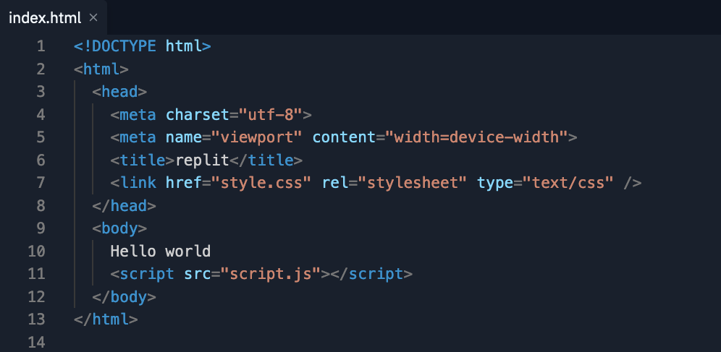
HTML

Slide 10
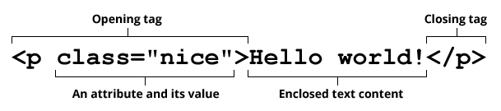
HTML Syntax
https://developer.mozilla.org/en-US/docs/Glossary/HTML

Slide 11
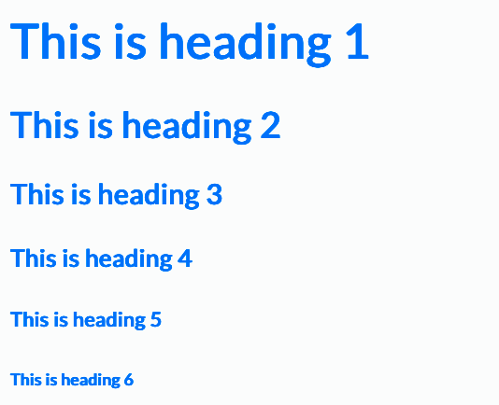
HTML Headings

Slide 12
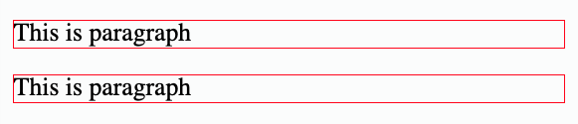

HTML Paragraphs & Divisions
<p>This is paragraph</p>
<p>This is division</p>

Slide 13
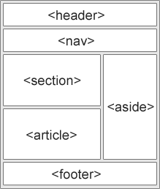
HTML Semantic Elements
https://www.w3schools.com/html/html5_semantic_elements.asp

Slide 14
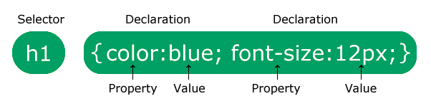
CSS Syntax
https://www.w3schools.com/css/css_syntax.asp

Slide 15
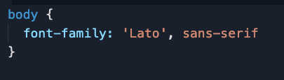
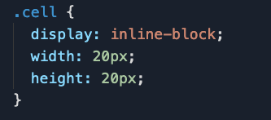
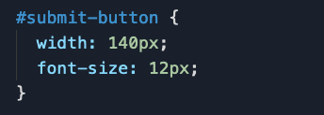
CSS Selectors
> CSS Element
> CSS ID
> CSS Class

Slide 16
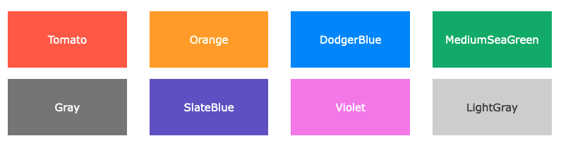
CSS Colors
…etc…
https://www.w3schools.com/css/css_colors.asp

Slide 17
Other CSS Styling
Align
Float
Background
Size
Position
Display
Z-index
Border
Margin
Padding
…etc…

Slide 18
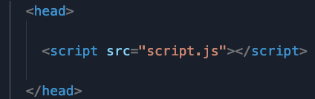
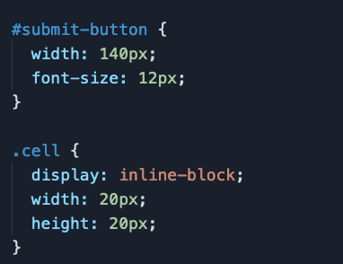
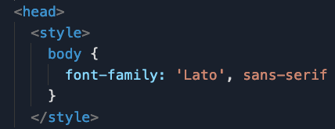
Adding CSS
> Inline CSS
> Internal CSS
> External CSS

Slide 19
JavaScript
JavaScript (JS) is a scripting or programming language
that allows you to implement complex features on web pages

Slide 20
Overview

Slide 21
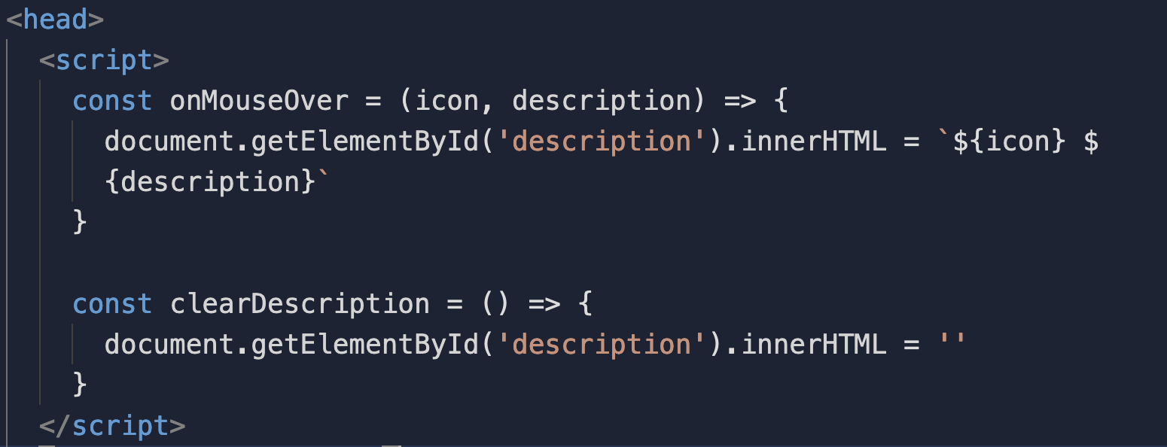
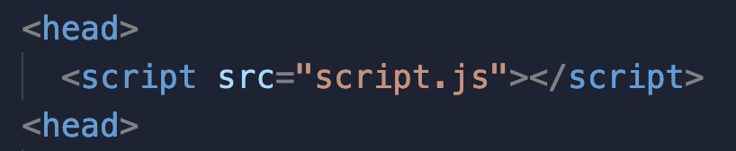
Adding JavaScript
> Internal JavaScript
> External JavaScript

Slide 22
JavaScript Variables
> var (global scope & mutable)
> let (block scope & mutable)
> const (block scope & immutable)

Slide 23
JavaScript Data Types
> number
> string
> boolean
> array
> object
> undefined

Slide 24
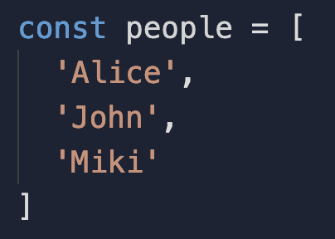
Arrays

Slide 25
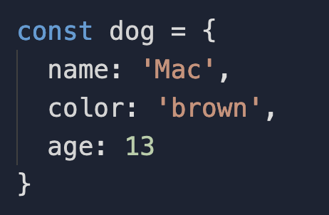
Objects

Slide 26
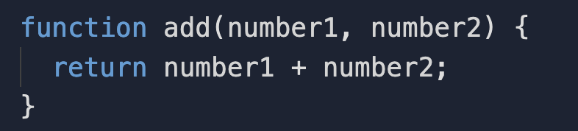
JavaScript Functions
Function is a set of statements that performs a task or calculate a value

Slide 27
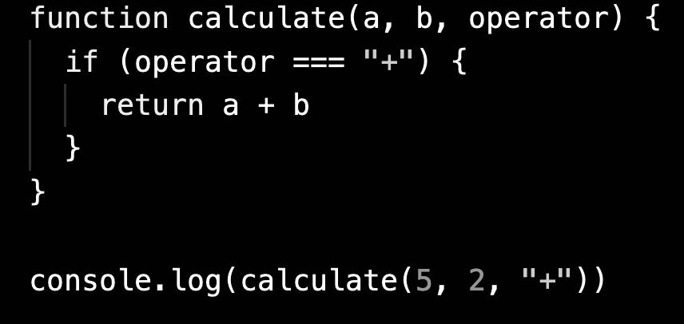
JavaScript Conditions (if/else)

Slide 28
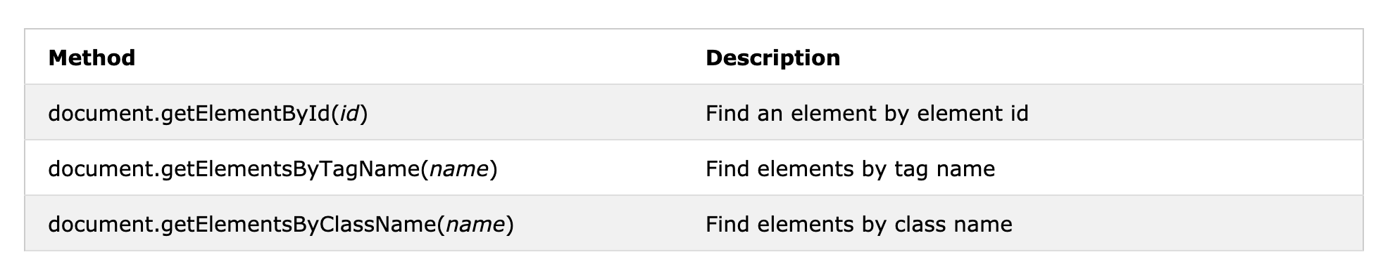
Finding HTML Element

Slide 29
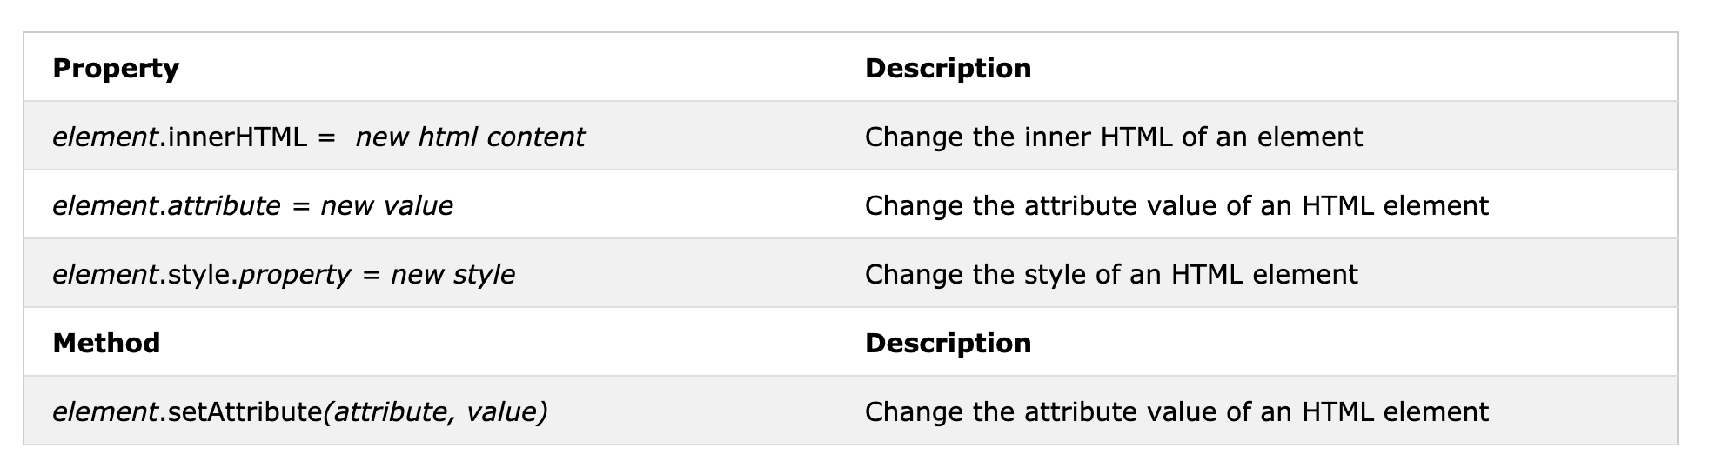
Changing HTML Element

Slide 30
Reference
https://developer.mozilla.org/en-US/docs/Web/JavaScript
https://www.w3schools.com/

